Slide 1


Github
Optimization of routers placements in wireless mesh networks
phase B
Supervisor: Prof. Miri Weiss-Cohen 23-2-R-11
Presented By:
Omer Rogel Marom Blumenfeld

Slide 2
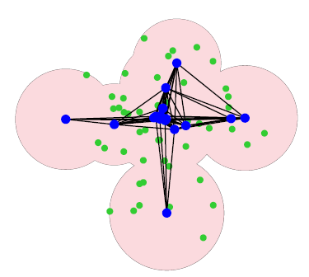
Project overview
Our project focused on evaluating optimization algorithms for solving spatial router deployment challenges. The primary objective was to achieve a well-connected network layout that maximizes customer connectivity and robust inter-router connections, ensuring reliable WiFi coverage across the designated area.
Input: Output:
1.Number of routers
Number of client (with location) 2.
3. Area intended to be covered
(room/garden/public building).
Optimal deployment
1

Slide 3
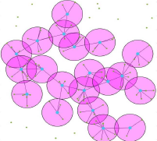
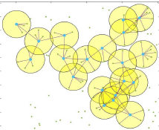
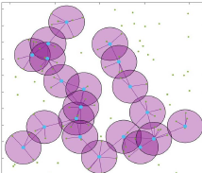
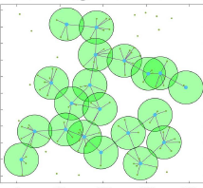
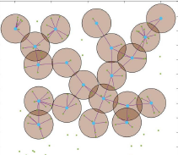
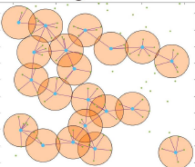
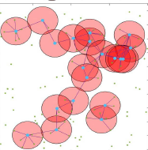
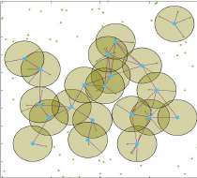
Project overview
A wide range of solutions and their rating:
73.5 88.7 82.0 61.7
75.4 64.2 59.6 53.4
2

Slide 4
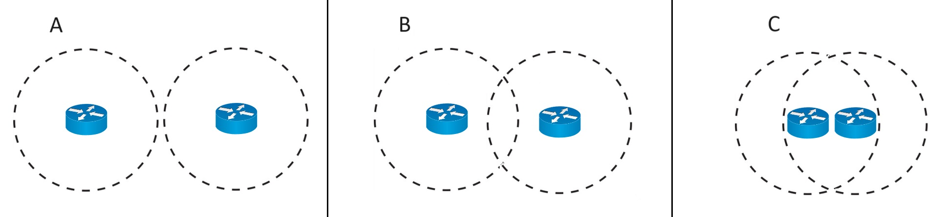
Router connectivity visualization
This key concept is the necessity for routers to be within transmission range of each other to establish a network.
Non-neighboring routers Non-neighboring routers Neighbor routers
3

Slide 5
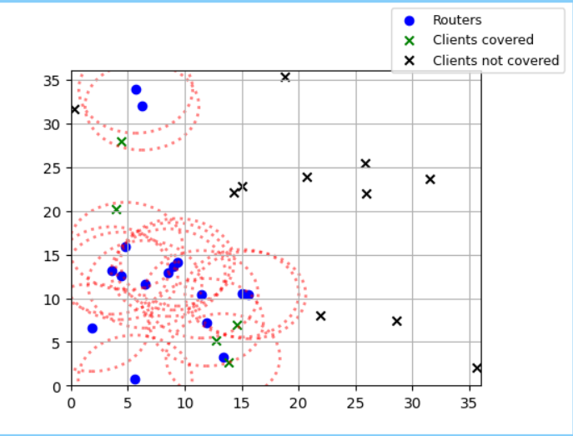
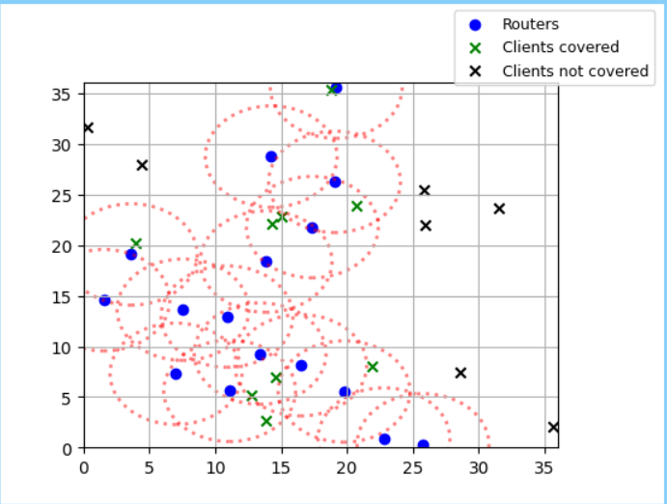
The need for developing
Addressing the need for efficient router placement in wireless mesh networks for optimal configuration and improve network performance.
Meeting the demand for reliable and scalable wireless networks in various applications.
Offering a user-friendly interface for easy use and understanding, making it accessible to a wide range of users.
4

Slide 6
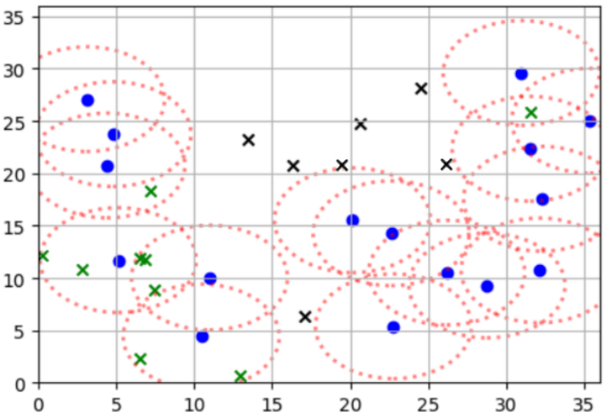
Our system main demands
To develop a tool that could optimize the placement of routers in wireless mesh networks to improve network performance.
To create a user-friendly interface that could visualize the optimized router placements and provide insights into the network performance.
Monitor:
Coverage
Giant component size
Fitness score
Deployment:
5

Slide 7

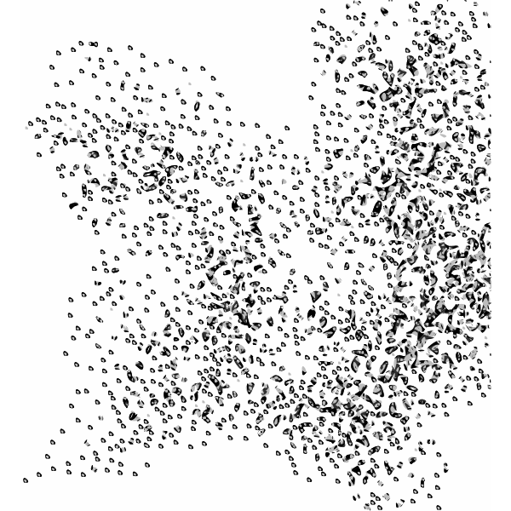
Optimization algorithms selection
The decision to implement Genetic Algorithm (GA) and Particle Swarm Optimization (PSO) stemmed from their adaptability and effectiveness in searching for optimal solutions. GA leverages evolutionary principles, while PSO mimics swarming behavior to efficiently explore solution spaces.
GA
PSO
6

Slide 8
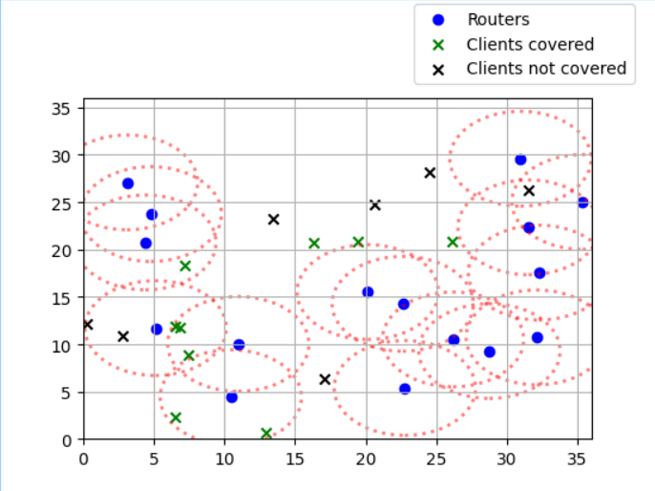
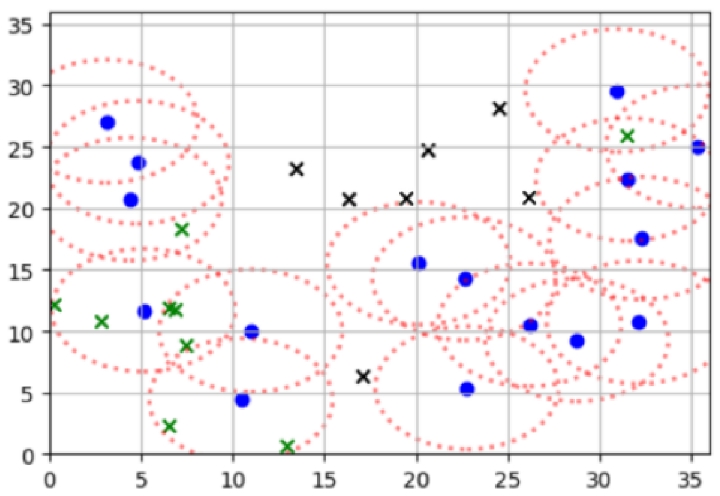
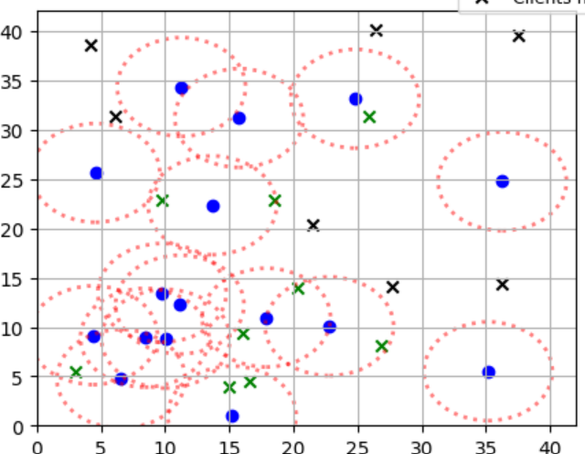
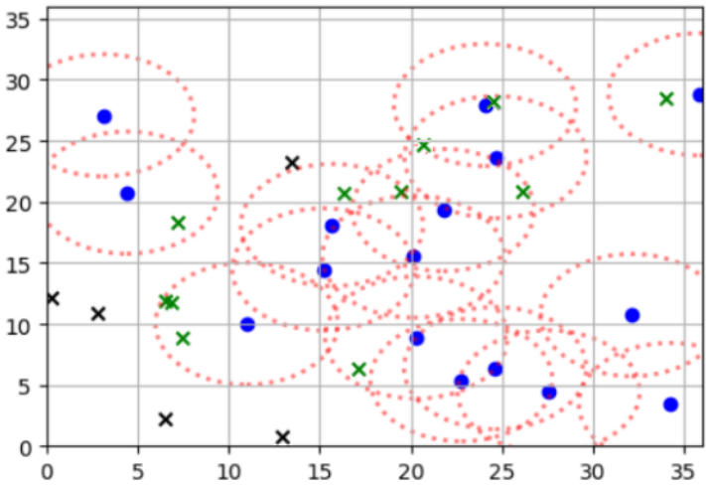
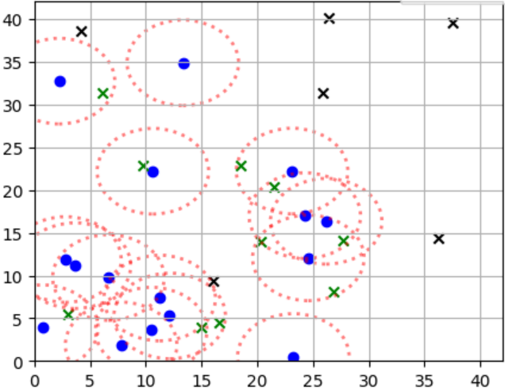
Genetic Algorithm (GA) overview
GA is an evolutionary optimization technique inspired by the principles of natural selection and genetic inheritance, it operates by iteratively evolving a population of candidate solutions using genetic operators.
Grandparents Parents Son
7

Slide 9
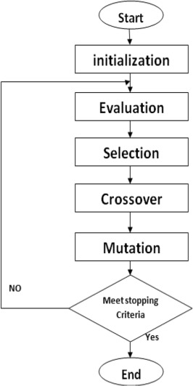
GA flowchart
In each iteration of GA, potential solutions undergo selection based on fitness evaluation. Crossover and mutation operations generate new solutions, refining the population toward optimal configurations.
8

Slide 10
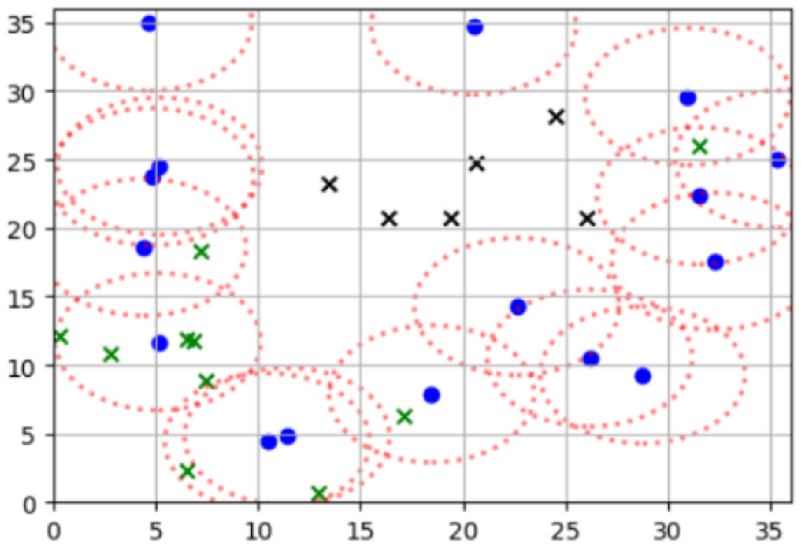
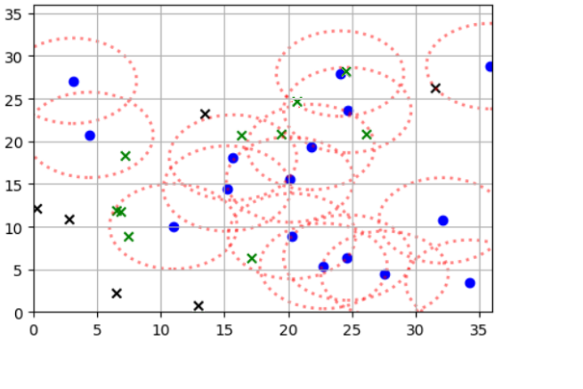
GA in our program
In the context of WMN, GA works by evolving a population of potential solutions, representing router placements over generations. it is gradually improving the solutions' fitness until an optimal placement is found for the mesh network.
9

Slide 11
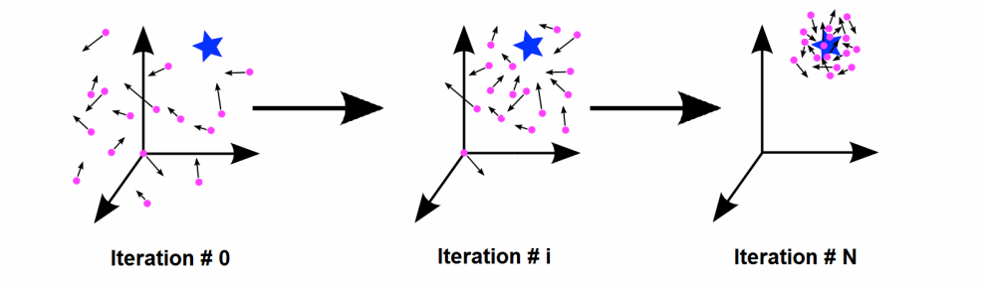
Particle Swarm Optimization (PSO) overview
Particle Swarm Optimization (PSO) is a population-based optimization technique where particles (representing potential solutions) adjust their positions based on local and global best-known positions. This cooperative behavior enables efficient exploration of solution spaces.
10

Slide 12
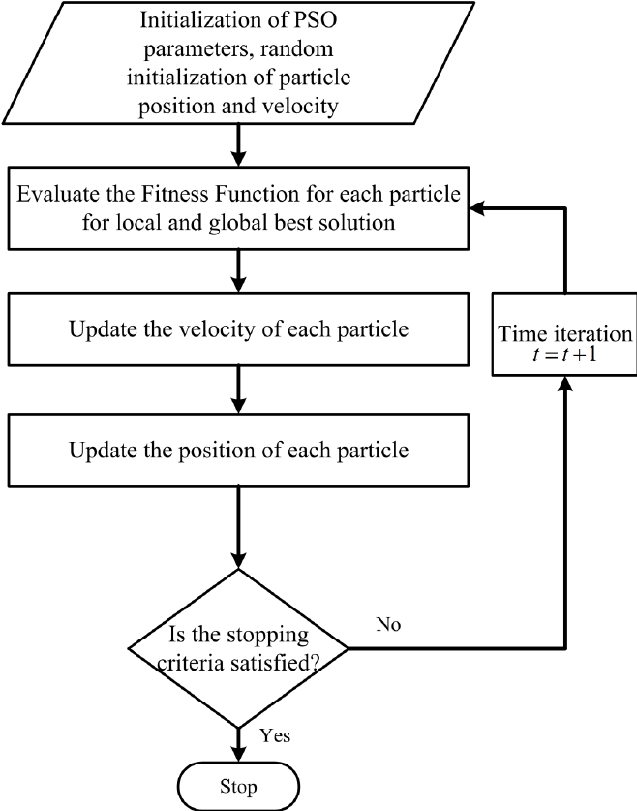
PSO flowchart
PSO iteratively updates particle positions, emphasizing the balance between individual particle exploration and exploitation of promising solution areas. The algorithm dynamically adjusts particle velocities to converge toward optimal solutions.
11

Slide 13
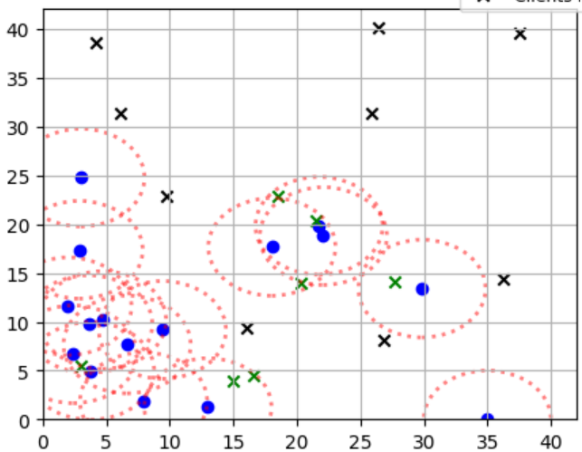
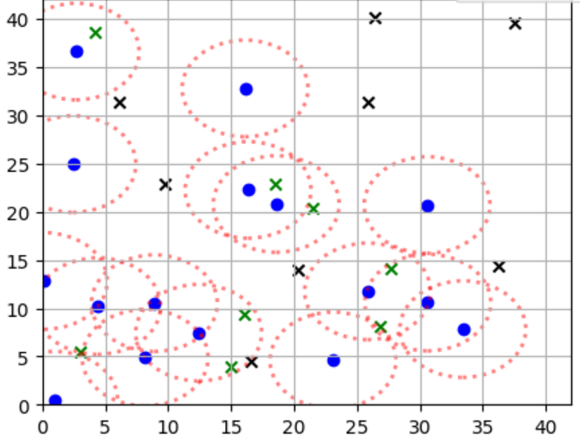
PSO process
Iteration 5
Iteration 10
Iteration 20
Iteration 50
12

Slide 14
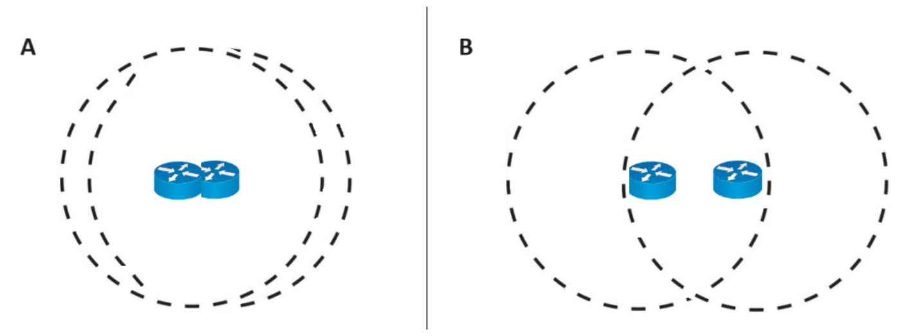
Fitness function design
The fitness function was designed to evaluate layout quality based on coverage percentage and connection component size. Additionally, we incentivized optimal router placement by rewarding configurations that maintain specific distances between routers, enhancing network efficiency.
The layout of the routers in Figure B is better than Figure A, so its score will be higher.
13

Slide 15
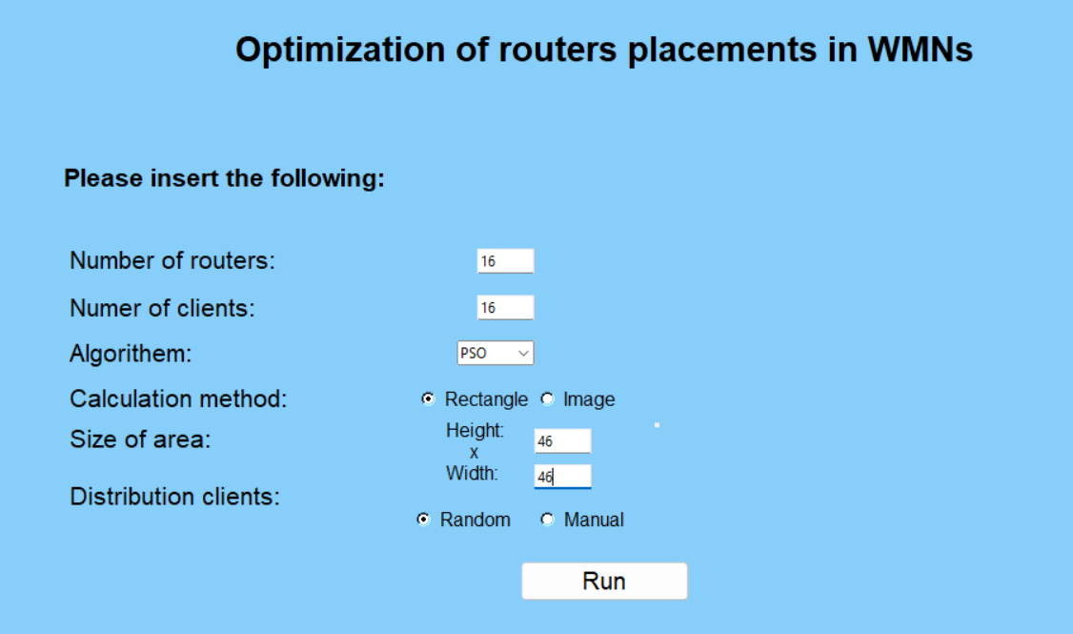
Our solution
We developed a software tool that optimizes the placement of routers in wireless mesh networks using Genetic Algorithm and Particle Swarm Optimization algorithm.
14

Slide 16


Technologies that were used during development
Python was used as the primary programming language for the development of the Genetic Algorithm and Particle Swarm Optimization
We used Pycharm as our Python distribution.
Git was used for version control to manage code changes and collaboration between team members.
15

Slide 17



Technologies that were used inside the program
Various data structures, such as lists and dictionaries, were used to store and manage data related to routers, clients, and network.
We utilized various Python libraries, including NumPy, math and random for numerical computing
Matplotlib and tkinter was used to visualize the results of the optimization process, such as the placement of routers and network performance metrics.
16

Slide 18
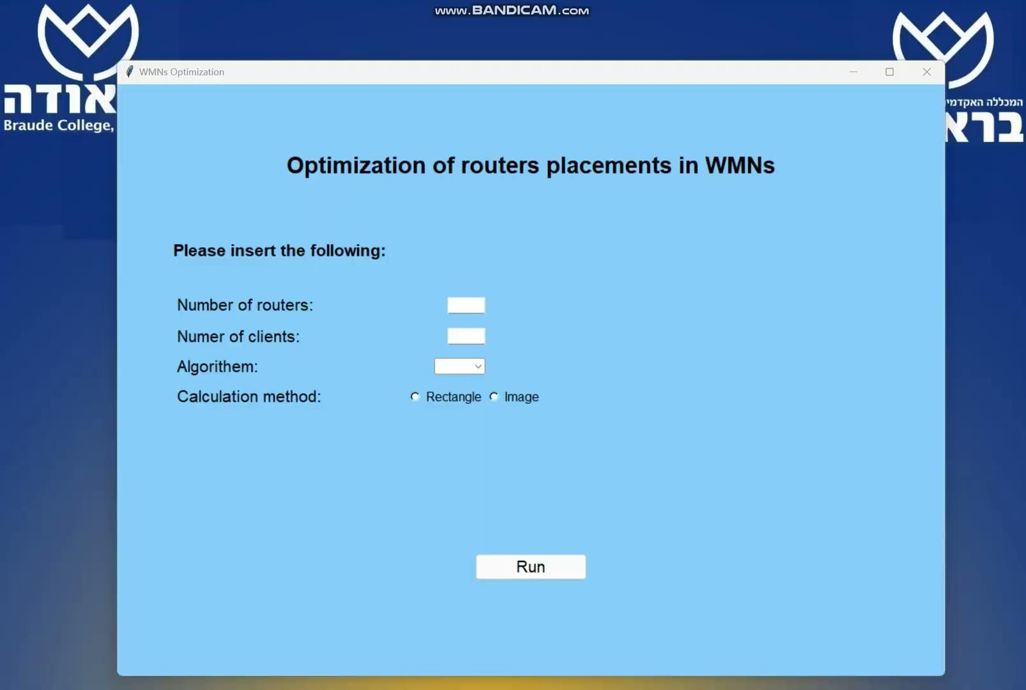
Software demonstration video
17

Slide 19
Results
Genetic Algorithm:
Leans towards client coverage over creating a single large mesh network.
Final output showed a fair distribution of routers in the sub-networks.
Particle swarm optimization:
Produced better results in terms of giant component size and overall network connectivity compared to GA.
PSO converges faster to an optimal solution, indicating its efficiency in navigating solution spaces.
18

Slide 20
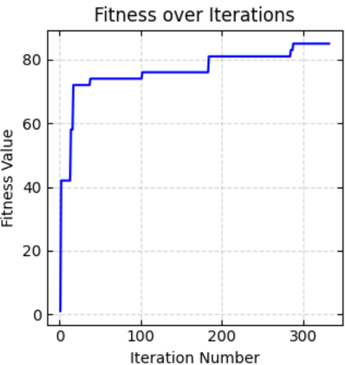
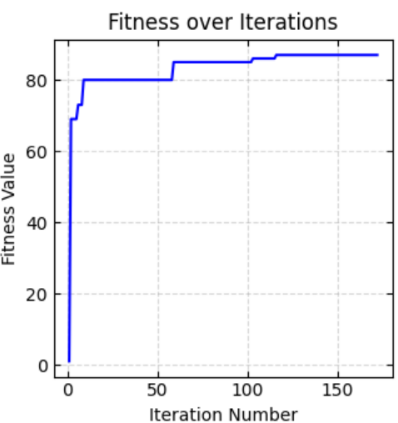
Results
GA: PSO:
19

Slide 21
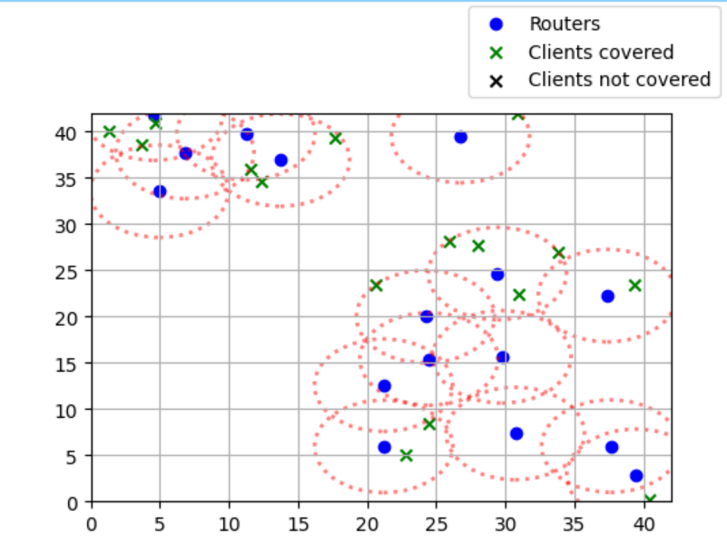
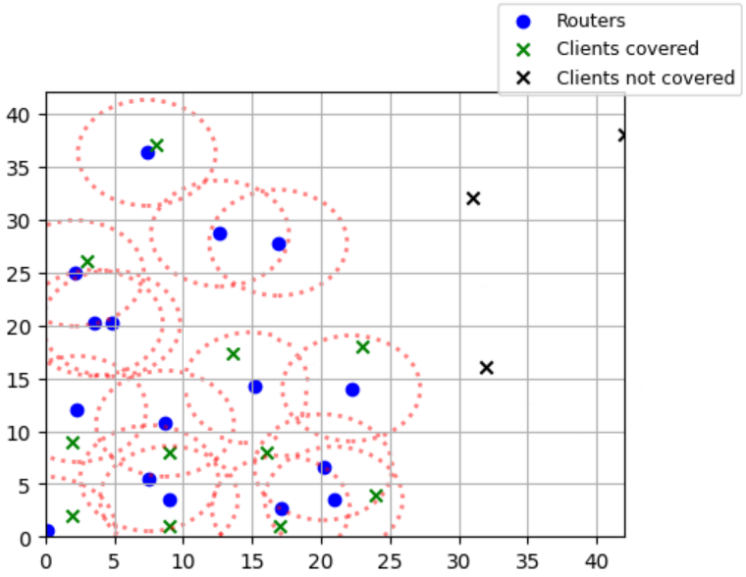
Results
GA after 300 iterations: PSO after 150 iterations:
20

Slide 22
Average results table
Algorithm | Iteration number | Size | Coverage | Giant component size | Fitness value
GA | 300 | 42x42 | 82% | 4 | 83.1%
PSO | 300 | 42x42 | 77% | 8 | 87.8%
GA | 300 | 36x36 | 89% | 6 | 88.3%
PSO | 300 | 36x36 | 83% | 9 | 92.8%
21

Slide 23
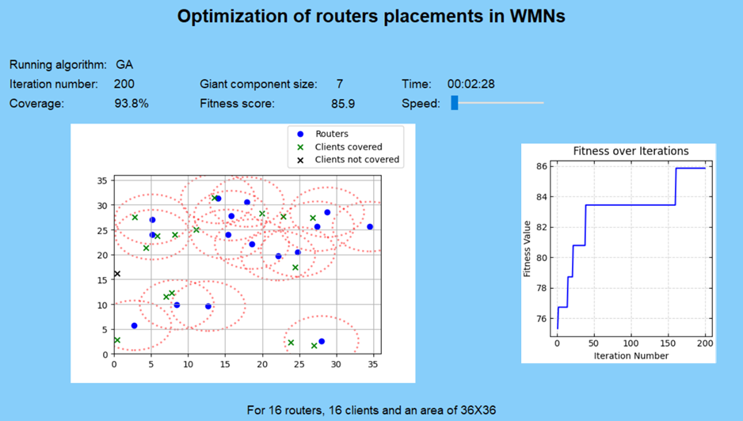
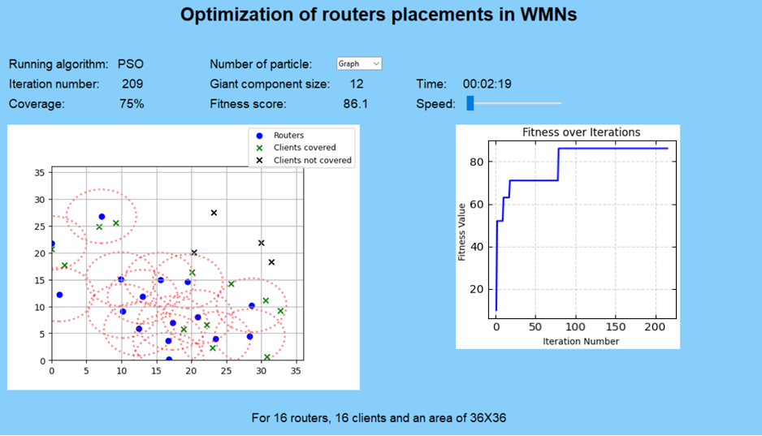
Result images
GA: PSO:
22

Slide 24
Project goals
Develop a sophisticated algorithmic solution for optimizing the placement of routers in Wireless Mesh Networks using GA and PSO - achieved.
Create a software program with a user-friendly interface for intuitive interaction, providing data into network performance and router placement strategies - achieved.
Enhance network coverage, minimize interference, and improve overall network in terms of router placement - semi-achieved.
23

Slide 25
Challenges and dealing with them
Understanding the underlying principles of GA and PSO
in-depth study of algorithmic complexities.
Implementing the GA and PSO algorithms in Python ensuring efficiency, scalability
a step by step coding and testing.
Establishing parameters and weights for the fitness function
careful tuning and evaluation to achieve an optimal solution.
Balancing the workload between team members
effective communication, and collaboration.
24

Slide 26
Conclusions
Genetic Algorithm:
Suitable for establishing multiple mesh networks in a desired area with several mesh clients.
Particle swarm optimization:
Recommended for a connected mesh network focused on connectivity over coverage.
A common conclusion drawn from the study is the necessity for each algorithm to have a unique fitness function.
25

Slide 27
Conclusions
We hypothesize that PSO's success can be attributed to its swarm-based approach, which efficiently explores solution spaces and adapts based on local and global information. In contrast, GA's reliance on evolutionary processes may have contributed to its slightly less optimal solution .
26

Slide 28
Thank You!
27

Slide 29
References
Rastin Pries, Barbara Staehle, Dirk Staehle, Phuoc Tran-Gia.(2010, January). On Optimization of Wireless Mesh Networks using Genetic Algorithms.
Shinji Sakamoto, Tetsuya Oda.(2016, April). Implementation and Evaluation of a Simulation System Based on Particle Swarm Optimization for Node Placement Problem in Wireless Mesh Networks.
Tetsuya Oda, Aoto Hirata, Nobuki Saito ,Kazuho Kanahara.(2020, May). Approach of a Solution Construction Method for Mesh Router Placement Optimization Problem.
SYLIA MEKHMOUKH TALEB, YASSINE MERAIHI, ASMA BENMESSAOUD GABIS.(2022, April). Solving the Mesh Router Nodes Placement in Wireless Mesh Networks Using Coyote Optimization Algorithm.
28

